Slide 1





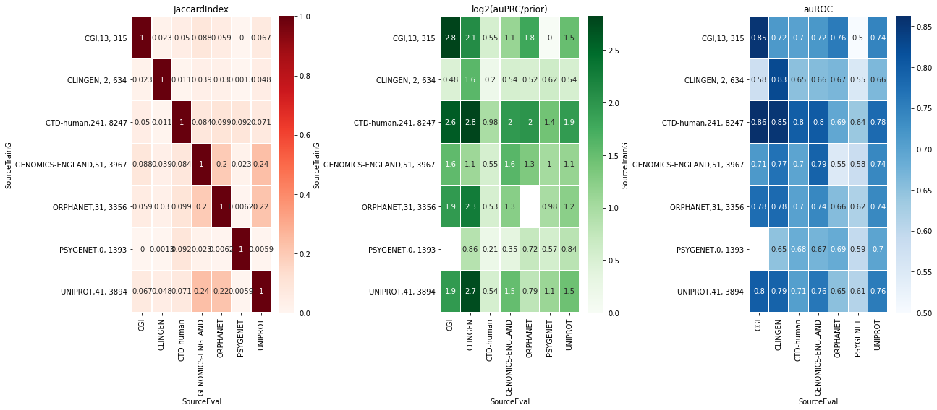
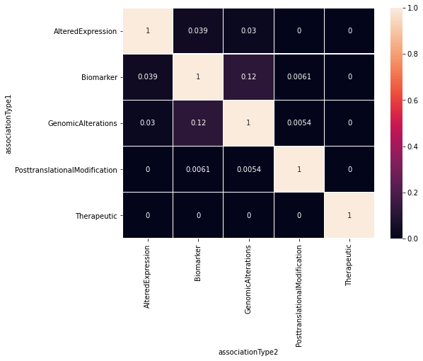
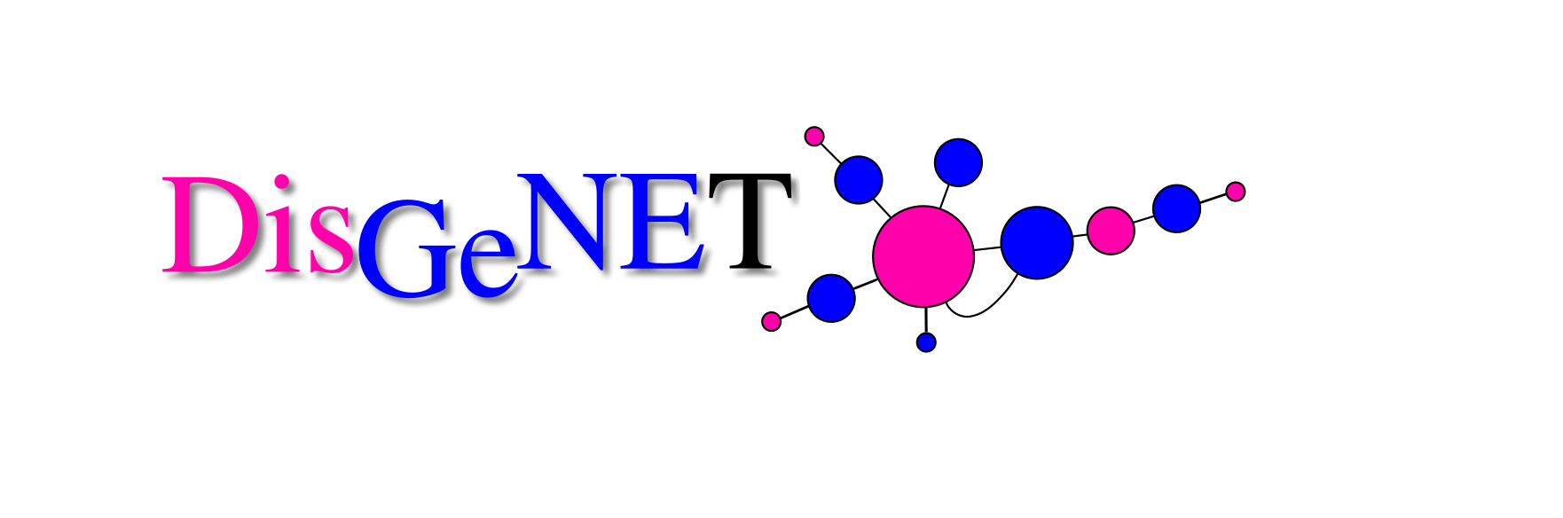
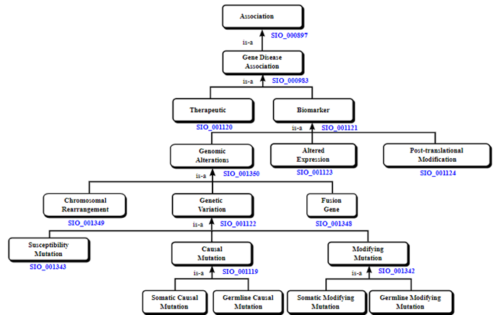
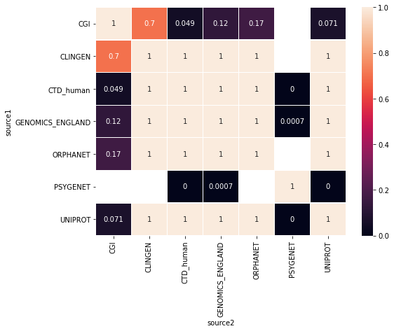
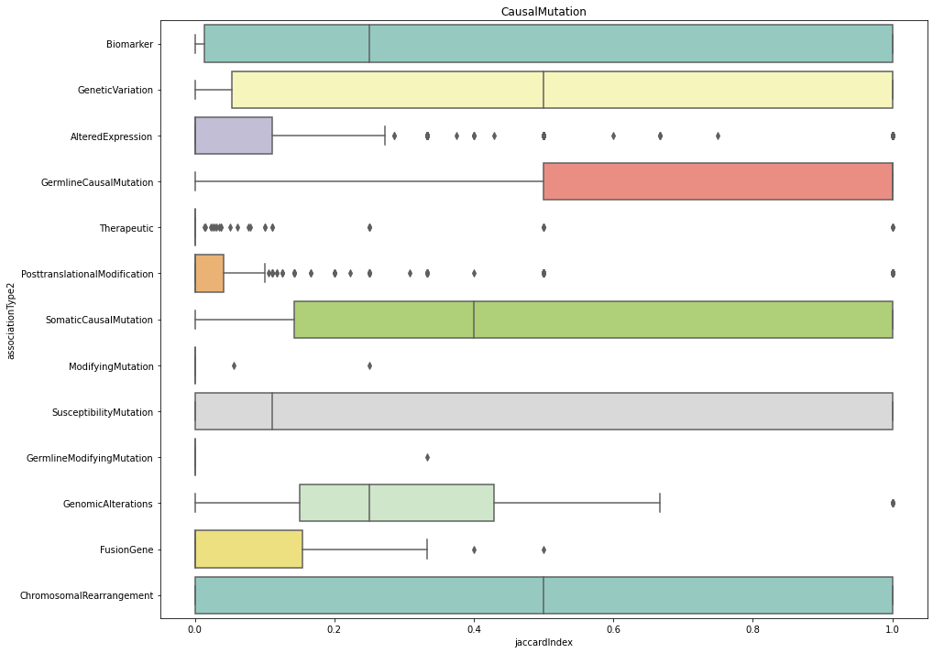
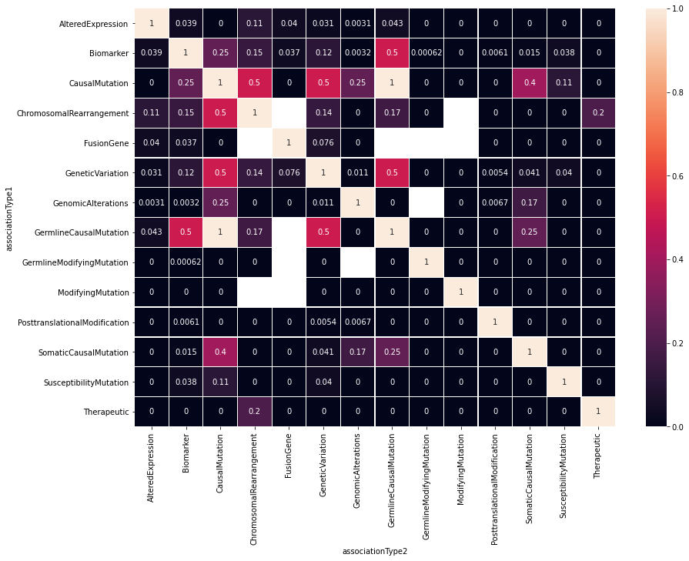
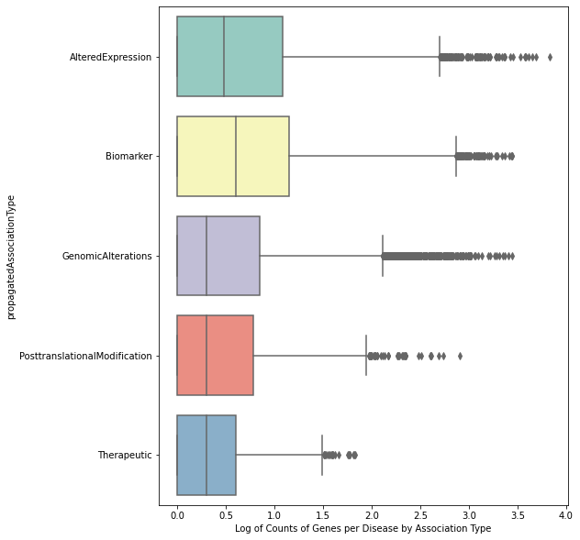
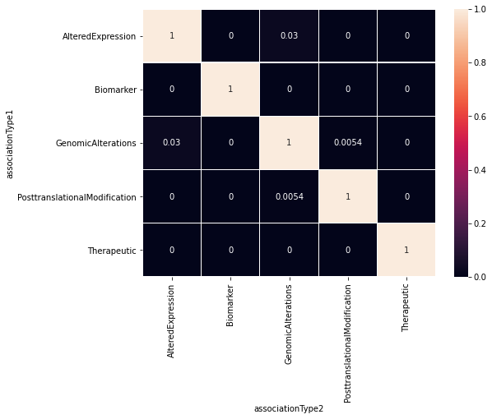
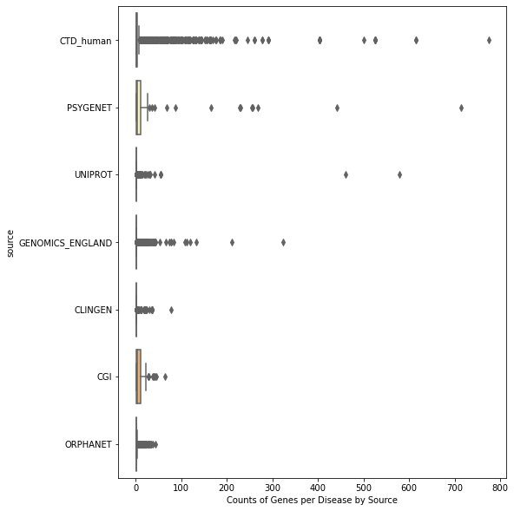
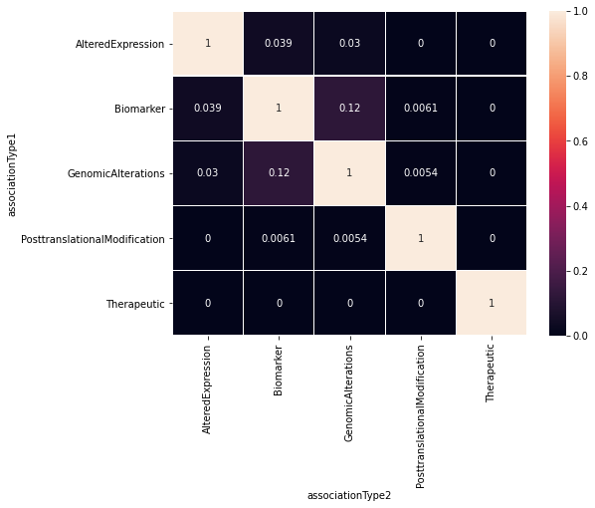
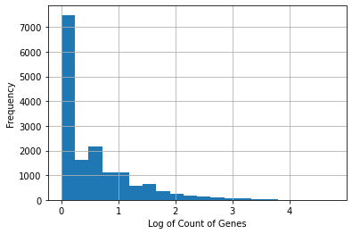
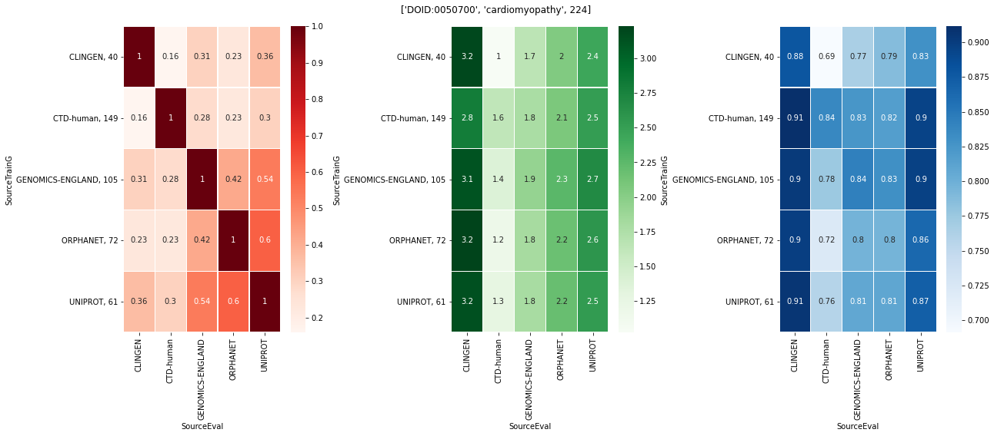
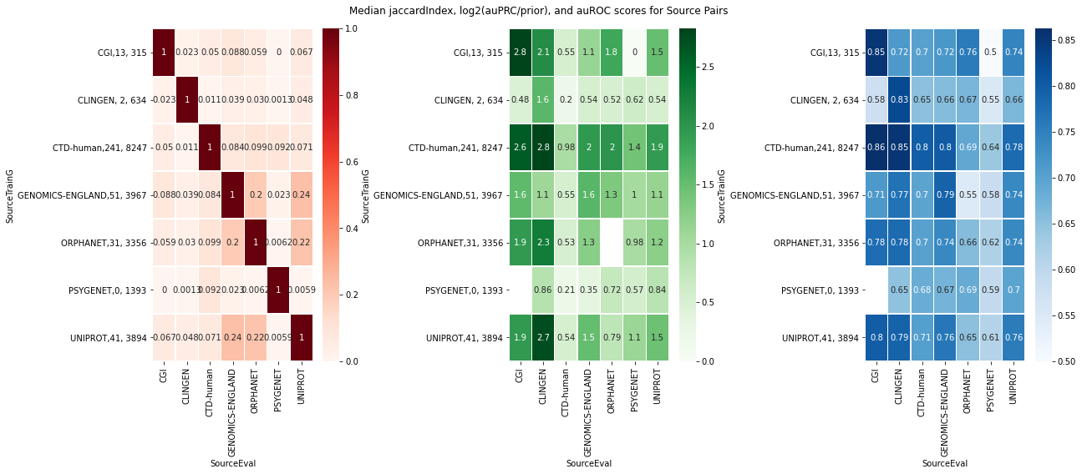
EXPLORATION AND ANALYSIS OF GENE-DISEASE ASSOCIATIONS
Arun Agarwal*, Anna Yannakopoulos⁑, Dr. Arjun Krishnan⁑
*Temple University, ⁑Michigan State University
Introduction
Association Type Exploration
Machine Learning Model Approach
The trillions of cells in the human body are each sustained by the activities of thousands of genes in the genome
Genetic mutations prevent one or more of these genes from working properly
Critical gene mutations can disrupt normal development and cause a medical condition
Many diseases, disorders, traits, and clinical or abnormal human phenotypes arise due to the contribution of disruptions in multiple genes
To work towards cures for such complex diseases, the human genome has been studied through various experimental methods, each providing a different and sometimes unique understanding of the disease’s underlying genetic cause.
Performed data exploration of the disease-gene data and the correlated association type hierarchy (Figure 1) to understand gene distribution per disease for each source
Propagated the dataset: assigned gene-disease pairs to ancestor association types based on the hierarchy
Recategorized the dataset into five association types: Therapeutic, Genomic Alterations, Altered Expression, Post-translational Modification, Genetic Variation, and Biomarker for more succinct plots
Compared gene sets from the same disease—yet separate association types—to quantify the overlap between association types using Jaccard Similarity Coefficient (Figure 2)
Filters on the curated data:
Extracted all diseases descending from one of 14 higher-level terms using a disease ontology
Kept data with at least 10 genes from at least 3 sources after propagation to be able to draw interesting conclusions from multiple sources
Retained data with at least 5 direct gene annotations to ensure the dataset contains disease-gene relationships directly from DisGeNET and not only from propagation
Applied a supervised machine learning approach to determine if, for any given disease, models trained on one source can predict genes associated to another source
Visualized various performance metrics (Figure 4) from our disease-gene prediction model to highlight improvement of our novel framework over a random baseline
Objectives
We hypothesize that:
The genomic basis of complex diseases can be understood on a holistic level through the exploration and combination of genetic data from distinct sources, experimental methods, and association types.
We try to answer:
Do different experimental methods provide the same view of the underlying biology or present different aspects of it?
Can models trained on one experimental method predict the genes associated to another?
Figure 4: Heatmaps of Median Correlation Score Between Gene Sets, Log2(auPRC/prior) Score, and auROC Score for All Sources
About DisGeNET
Conclusion/Next Steps:
In this project, we obtained these data from the DisGeNET database, which integrates human gene-disease associations and variant-disease associations from expert-curated repositories, GWAS catalogs, animal models, and scientific literature to create one of the largest publicly available collections of genes and variants mapping over 30,000 human diseases to 20,000+ genes.
Figure 2: Heatmap of Median Correlation Between Gene Sets for Chosen Association Types
Overall, we determined some sources and association types demonstrate little correlation to others, represented by their low jaccard index values; however, a few provide similar views of the underlying biology. Furthermore, based on the performance metrics for certain sources trained or evaluated on, models trained on one experimental method can generally predict genes associated to another.
Future Work:
Combine the machine learning models from distinct sources into an ensemble model that discovers novel genes across the human genome associated with the disease
Make my work readily available to members of the Krishnan laboratory to allow for incorporation into further disease study and for continuation of the project
Such results can lead to a better understanding of the genomic basis of complex diseases and in the design of drugs that target and reverse the disease-related signals
Sources Exploration
Moved forward with a subset of the dataset containing only curated data that compares sources—CGI, CTD-human, CLINGEN, GENOMICS-ENGLAND, ORPHANET, PSYGENET, and UNIPROT—instead of association types
Created another overlap heatmap (Figure 3) and based on all the perfect correlations between source pairs, decided to filter the data to meet conditions like a minimum gene set size
Disease-Gene Attributes File
Gene Sets Dataset
Boxplots and Heatmaps
Curated Data File
Disease Mappings File
Propagated Dataset
Recategorized Dataset (Unique Biomarker)
Boxplots and Heatmaps
DOID Curated Dataset
Boxplots. Heatmaps, and Histograms
Recategorized Dataset (All Biomarker)
Boxplots and Heatmaps
Disease Ontology
Performance Metric Heatmaps
Filtered and Selected Diseases
Labels for Machine Learning Model
Cross-Validated Disease-Gene Predictions
Performance Metrics Dataset
Figure 5: Dataset and Process Summary
This project would not have been possible without the unwavering support from my mentors, the Krishnan Laboratory, and the ICER ACRES Program Staff.
Figure 1: Association Type Hierarchy developed by the DisGeNET Database
Figure 3: Heatmap of Median Correlation Between Gene Sets for All Sources
Contact: arun.agarwal.aaa@gmail.com
https://www.linkedin.com/in/arunagarwal23/

